Slide 1

Memory (Chapter 22) Lecture 3-4

Slide 2
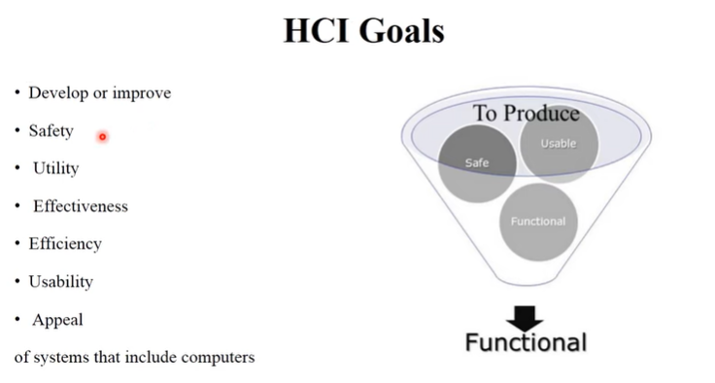
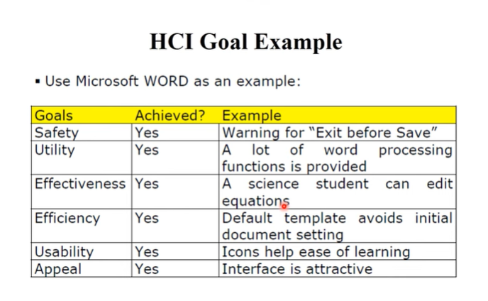

Slide 3
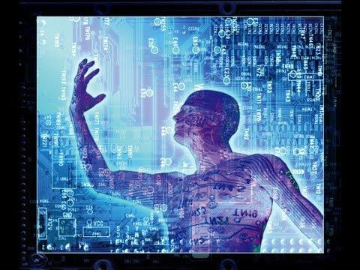
Introduction
The Human: Understanding Users

Slide 4
Introduction
User cognition is the mental process users use to perceive, process, and respond to information when using a system
Why we need to understand users?
Each user is different
User Cognition
Cognitive process refers to seeing, touching, hearing, smelling, tasting, thinking, learning, remembering, decision-making, reading, writing and talking, and so on
Two kinds of Cognition (Norman, 1993)
Experiential Cognition: it refers to perceive, act, and react to events that occur in surroundings efficiently and effortlessly. It requires a level of expertise and engagement (e.g. drive a car, reading a book)
Reflective Cognition: it refers to thinking, comparison and decision making that lead to new ideas and creativity (e.g. designing, learning and writing a book)
Cognition involves memory and its process that need to be taken into account to understand its types, capacity and limitations
User(s) Attention
User(s) Emotions influence their capabilities
Long term

Slide 5
Introduction
Memory is an ability to take in information, encode it, store it, and retrieve it at a later time
Memory is not a simple information store. It is a constructive process, in which, information is broken into three stages, i.e. Encoding, Storing and Retrieving.
It is affected by the type of information to be stored
It is an active repository
It cannot be studied meaningfully in isolation.
Types of Memory
Sensory memory -Sensory memory briefly holds information from your senses (sight, sound, smell, touch).
Short term/Working memory-Short-term memory holds information for a few seconds or minutes while you actively use it. Ex-OTP
Long term-Long-term memory stores information for days, years, or even a lifetime. Ex-YOUR Name-DoB

Slide 6
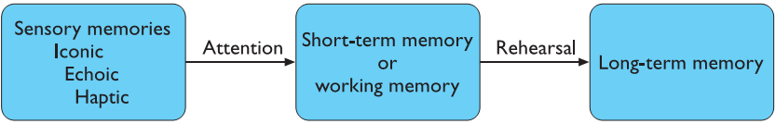
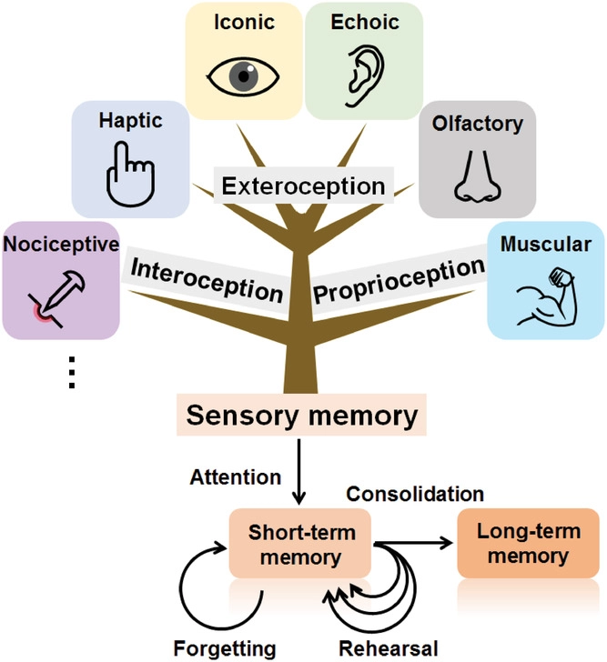
Memory Stores
Body position
(External senses)
Pain sensation
Body position
(Internal body senses)

Slide 7
Sensory Stores
Iconic, echoic, and haptic
Temporary stores / buffers
Continuously overwritten
Info transferred within a fraction of a second
Examples: Fireworks Trail or Moving Finger

Slide 8
Working Memory [1/3]
Central executive
Serves as a system for processing, working with current info
Parallel activities
Decision making and planning
Visual-spatial sketchpad/scratchpad
Visual and spatial info
Mind’s eye
Limited capacity: 4-5 items (7 ± 2??)
Last the info: 20 Seconds
Articulatory loop
Audio info
Inner voice

Slide 9
Working Memory [2/3]
rapid access ~ 70ms
rapid decay ~ 200ms
Rehearsal
Repeating info oneself without attempting to finding meaning
Info loss if not rehearsed
Refreshing the contents
Chucking
Grouping items to make them easier to remember
The Primacy-Recency Effect
Recalling information presented at the beginning and end of a list
For example: Forgetting things in the middle
Displacement
New contents replace old ones

Slide 10
Working Memory [3/3]
Examples
05190495337
051 9049 5337
HEC ATR ANU PTH ETR EET

Slide 11
Long-Term Memory [1/3]
Unlimited memory
Lifetime storage
Organized as a network of connected chunks of knowledge
Semantic memory
Well-structured information about languages, things, events and incidents
Knowledge of facts and concepts about world
For example, knowledge of language including its rules, words and their associated meaning (info: coded with meaning)
Info is taken into account related to five senses i.e. coded in different forms too e.g. memory of music or bark of dog are encoded as auditory information
Info: of haptic touch i.e. encoded to remember as feeling of silk or sting cut
Info: related to sense of smell and taste could be encoded to remember as taste and smell of very fresh and rotten food
Episodic/Autobiographical memory
Personal history
For example, Admission day or Graduation Day and etc.

Slide 12
Long-Term Memory [2/3]
Procedural memory
It is a memory of learned skills that does not require conscious recollection
It stores information that let us know how to do/operate
For example, how to drive a car
Permastore
Lifetime storage
Declarative: It is a memory of knowledge that can be called forth consciously as needed

Slide 13
Long-Term Memory [3/3]
Encoding/Registration of Information
The process of receiving, processing and storing the info:
Retrieval
Accessing the stored info:
Forgetting
Fail to recover info due to decay, interference, and repression
Levels of Processing (LoP)
Recognition (e.g. multiple choice questions)
Recall (e.g. membered information)

Slide 14
How and Why Do We Forget? [1/3]
Accessibility
Ability to retrieve information
Availability
Either information stored or not
Example
You find the book (the memory is retrieved)
The book is not in the library (the memory is not available)
The book is in the library but has been misfiled (not accessible)

Slide 15
How and Why Do We Forget? [2/3]
Forgetting from working memory
Decay theory (about 30 seconds)
Displacement theory
Forgetting from long-term memory
Different theories
Disuse (e.g. a foreign language)
Interference theory

Slide 16
How and Why Do We Forget? [3/3]
Retroactive interference
New info replaces the old one
Example: manual to automatic car
Proactive interference
Old info interferes the new one
Example: old and new phone number
Retrieval failure theory
Incorrect retrieval cue
‘Filing’ the memory in the wrong place
‘Tip of the tongue’ phenomenon (e.g. difficult to recall words with meaning)

Slide 17
Attention
Major human ability
Central to an activity
Selective attention
Awareness of sensory info
Cocktail party effect or Two different head phones
Divided attention
Mental resources
Multi-tasking (e.g. watching TV and holding conversation on mobile phone)
Result: Selective attention leads to excellent performance and Divided attention leads to poor performance

Slide 18
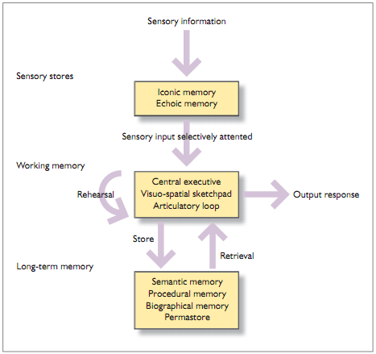
Schematic Model of Memory

Slide 19
Recap of Memory and its importance in HCI
Human memory is one of the mechanisms that determine person’s interaction with the outer world and helps in perceiving the objects that exist in world around us.
It helps in determining, processing, recognizing and perceiving the elements/objects of our surroundings
It helps in organize the data on the screen properly and strengthen information architecture of system
It is imperfect i.e. largely influenced by various factors such physical, social, psychological, emotional and etc.
It is deceptive, illusive or abstract, because, it is colored by today’s events/incidents as stated by Albert Einstein
Without memory: It could be difficult to imagine and make sense about system/life that could be purpose, meaning, and value of system/life
Without memory: No language, No art, No science and No culture
Memory and attention work together and enable us to act and react in surroundings accordingly. These two aspects of human beings introduce the possibilities of making mistakes, having accidents or doing things unintentionally
Memory, attention, and error are also associated/related to emotions

Slide 20
Recap of Memory and its importance in HCI
In this regard, it is essential to understand memory and its working nature from design perspective to design according to its capacity rather than against its capacities and limitations
It is important to know how memory works, and suggest to designers for creating human-centered interfaces which correspond to the natural abilities of the users, save their effort and boost positive usability/UX of systems/services/products
Understanding memory is important for user interface designs and also very useful for designing information visualization systems, very complex or critical systems/highly-intensive systems as whole to make these systems easily understandable for viewers/users in very short period of time
It enables in executing tasks and achieving goals and consequently leads in creating the excellent memories and memorable usability/user experience while interacting with products/systems/services

Slide 21
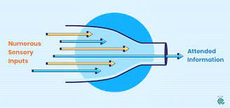
How Attention Works [1/2]
‘Bottleneck’ theories
Broadbent’s single-channel theory
Filtering info
Single-task processing
Capacity allocation
Limited resource
Multi-tasking
Other factors such as enduring dispositions and momentary intentions

Slide 22
Tips for memory-friendly Usability/UX
Don’t make users memorize many items at once
Don’t present too many elements for the choice together
Save memory effort with recognizable patterns and symbols
Apply consistent markers in navigation
Don’t hide the core elements of navigation
Stimulate different types of memory
Remember about emotions
Avoid burdening user’s memory working load

Slide 23
How Attention Works [2/2]
Automatic processing
Familiar tasks
Little or no demand on attention
Controlled processing
Unfamiliar tasks
Heavy demand on attention

Slide 24
Factors Affecting Attention [1/3]
Stress
Affects our ability to pay attention
Noise, light, and vibration etc.
Anxiety, fatigue, and anger etc.
Vigilance
the execution of a task wherein an individual is required to monitor an instrument or situation for a signal
Examples??
In-car systems

Slide 25
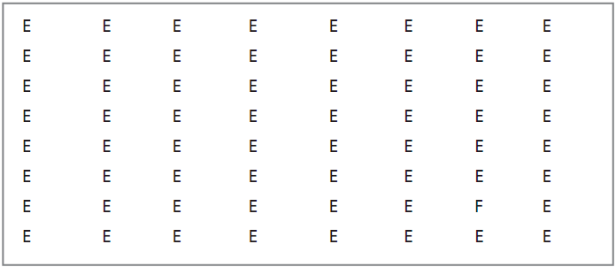
Factors Affecting Attention [2/3]
Mental workload
How busy is the user or operator?
NASA Task Load Index (NASA-TLX)
Mental demand, Physical demand, Temporal demand, Performance, Effort, frustration level
Visual search
Not consistent
Large, bright
Edge effect

Slide 26
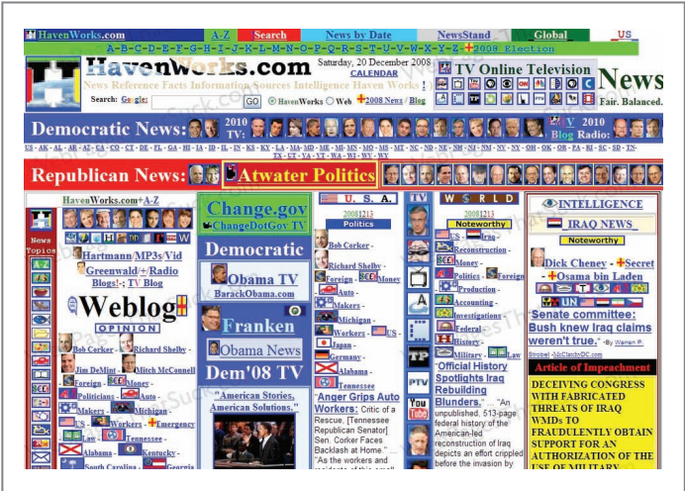
Factors Affecting Attention [3/3]

Slide 27
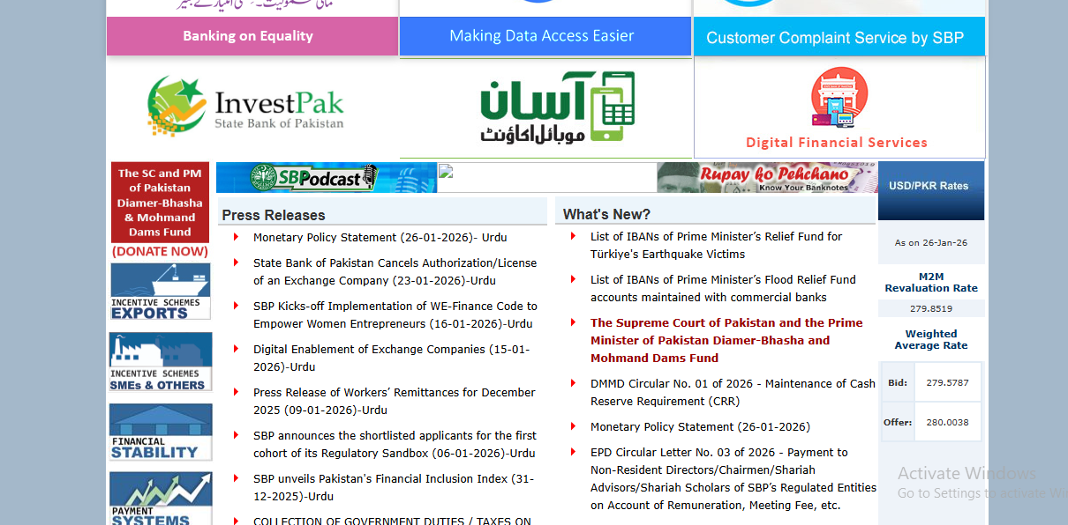

Slide 28
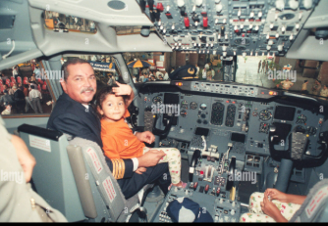
Human Error
Reducing action slips
Wizards
Step by step, next/back option

Slide 29
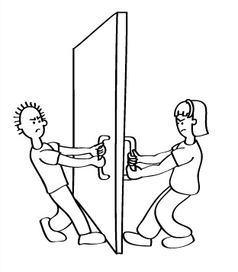
Activity!
Doors are very simple objects. Complex things may need explaining, but simple things should not.
When simple objects need pictures, labels, or instructions, then design has failed.

Slide 30
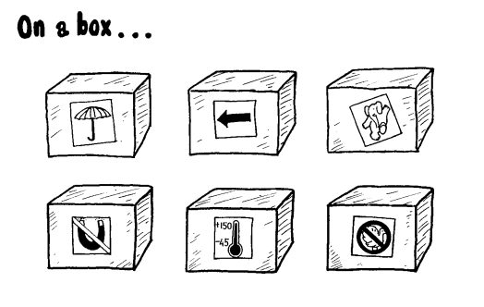
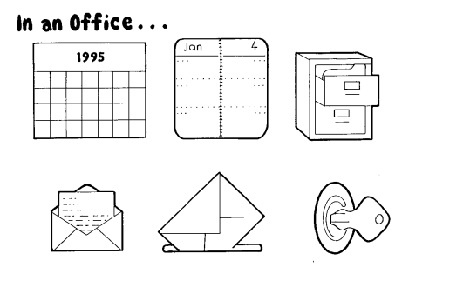

Slide 31
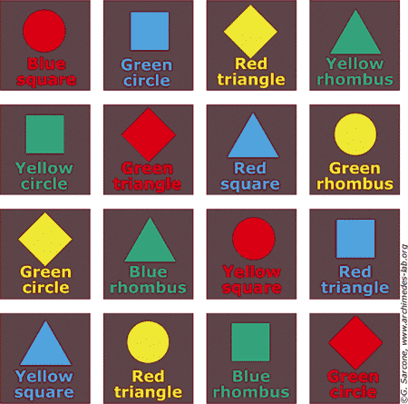
Stroop Effect
The Stroop Effect is a psychological phenomenon where your brain gets confused when the meaning of a word conflicts with what you see, causing slower reaction time or mistakes.
This leads to a discussion of frustrating and contradictory interfaces, and the need for interface designers to think more about their audience.

Slide 32
BLUE

Slide 33
GREEN

Slide 34
RED

Slide 35
PURPLE

Slide 36
BLACK

Slide 37
YELLOW

Slide 38
PURPLE

Slide 39
GREEN

Slide 40
BLUE

Slide 41
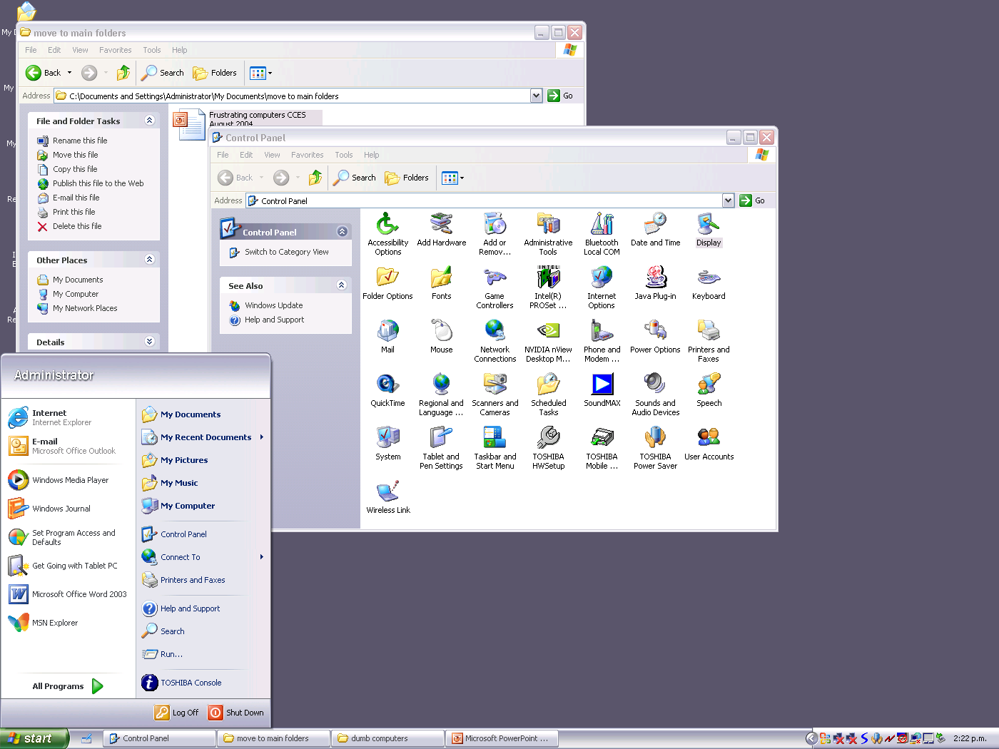
Stop the computer...

Slide 42
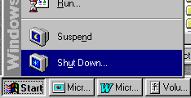
Stop the computer...

Slide 43
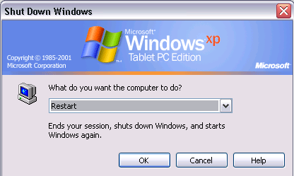
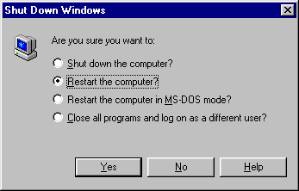

Slide 44
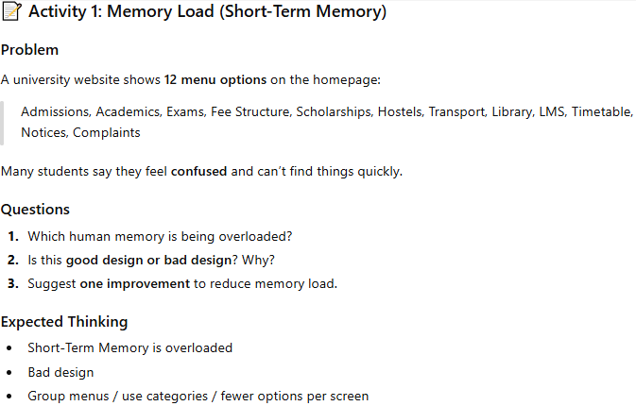

Slide 46
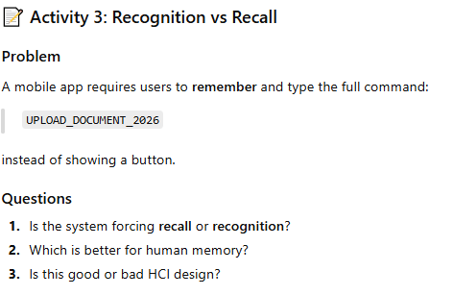

Slide 47
